Slide 1
Particle filters for Robot Localization
An implementation of Bayes Filtering
Markov Localization

Slide 2
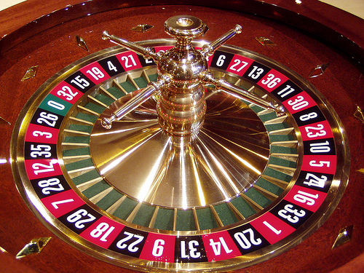
Monte Carlo Localization
Repeated
Random
Sampling

Slide 3
Particle Filters
Idea: Represent belief by random samples
Estimation of non-Gaussian, nonlinear processes
Monte Carlo filter, Survival of the fittest, Condensation, Bootstrap filter, Particle filter

Slide 4
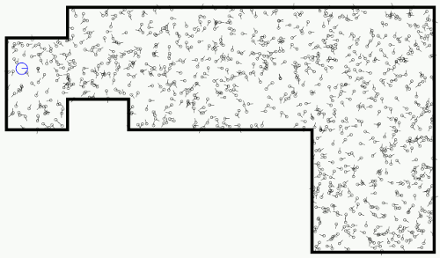
MC Localization
Start with lots of random samples (aka particles)
Weight each with probability based on sensor reading.

Slide 5
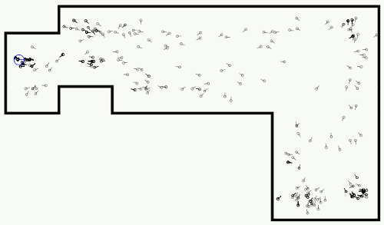
MC Localization
Given an action a,
Use importance weighting to select from the old particles
Probabilistically create new particle given action and motion model

Slide 6
Adaptive Monte Carlo Localization
often abbreviated AMCL

Slide 7
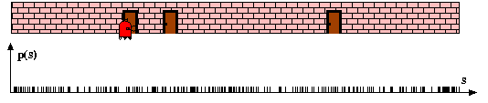
Particle Filters

Slide 8
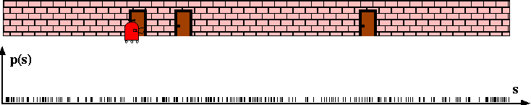
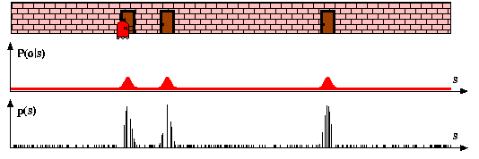
Sensor Information: Importance Sampling

Slide 9
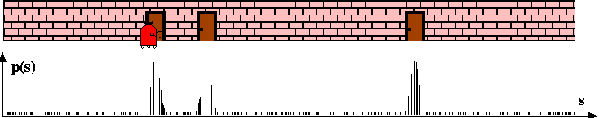
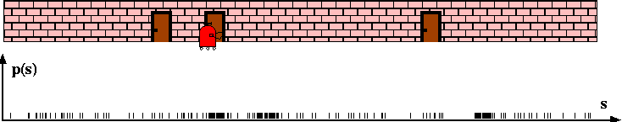
Robot Motion

Slide 10
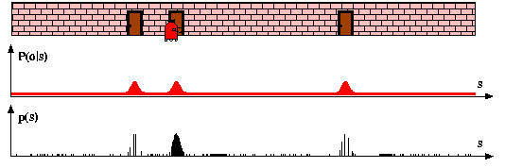
Sensor Information: Importance Sampling

Slide 11
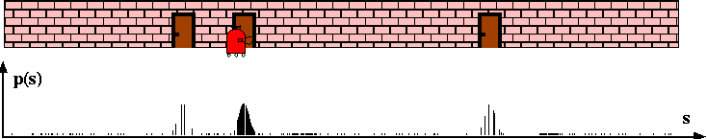
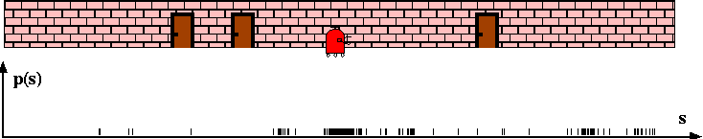
Robot Motion

Slide 12
Particle Filter Algorithm
Sample the next generation for particles using the proposal distribution
Compute the importance weights :
weight = target distribution / proposal distribution
Resampling: "Replace unlikely samples by more likely ones"

Slide 13
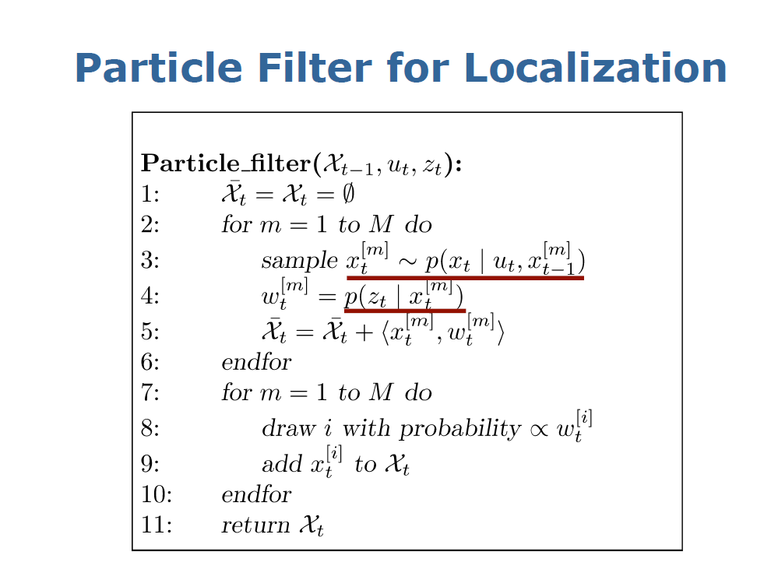

Slide 14
Particle Filter Algorithm
Algorithm particle_filter( S_{t-1}, u_{t-1} z_{t}):
For Generate new samples
Sample index j(i) from the discrete distribution given by w_{t-1}
Sample from using and
Compute importance weight
Update normalization factor
Insert
For
Normalize weights

Slide 15
Particle Filter Algorithm
draw x^{i}_{t−1} from Bel(x_{t−1})
draw x^{i}_{t} from p(x_{t} | x^{i}_{t−1},u_{t−1})
Importance factor for x^{i}_{t}:

Slide 16
Resampling
Given: Set S of weighted samples.
Wanted : Random sample, where the probability of drawing x_{i} is given by w_{i}.
Typically done n times with replacement to generate new sample set S’.

Slide 17
Resampling
w_{n}
w₁
w_{n}
w₁
w₂
w₂
W_{n-1}
W_{n-1}
w₃
w₃
Stochastic universal sampling
Systematic resampling
Linear time complexity
Easy to implement, low variance
Roulette wheel
Binary search, n log n

Slide 18
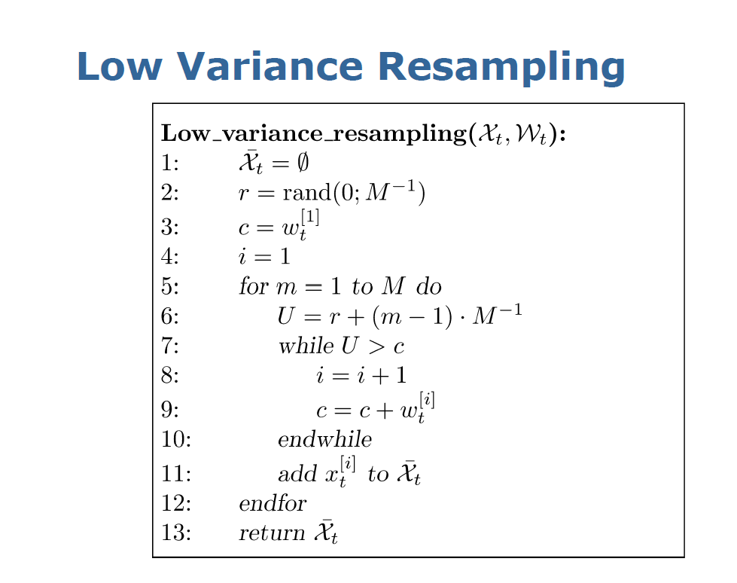

Slide 19
Resampling Algorithm
Algorithm systematic_resampling(S,n):
For Generate cdf
Initialize threshold
For Draw samples …
While ( ) Skip until next threshold reached
Insert
Increment threshold
Return S’
Also called stochastic universal sampling

Slide 20
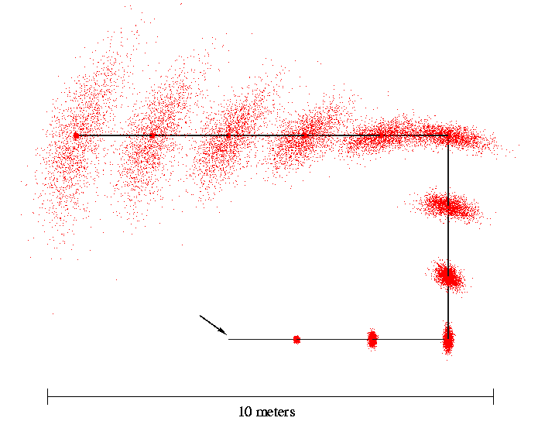
Motion Model Reminder
Start

Slide 21
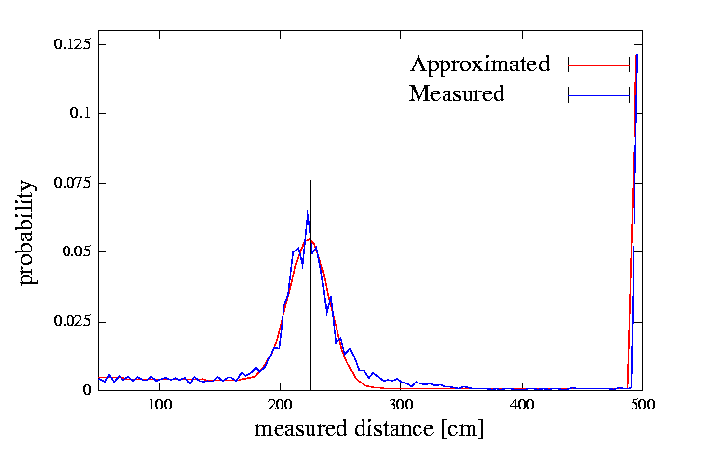
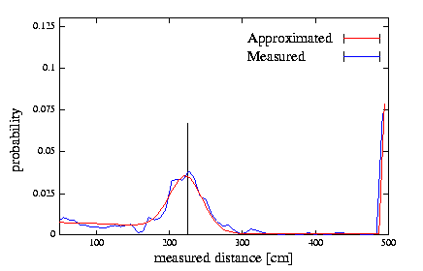
Proximity Sensor Model Reminder
Laser sensor
Sonar sensor

Slide 22
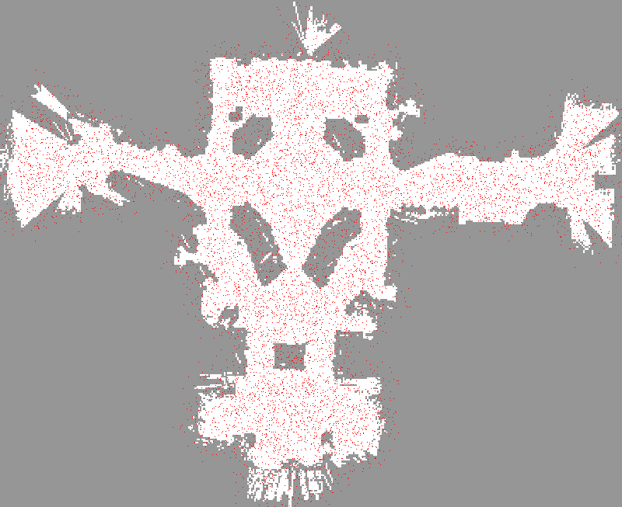

Slide 23
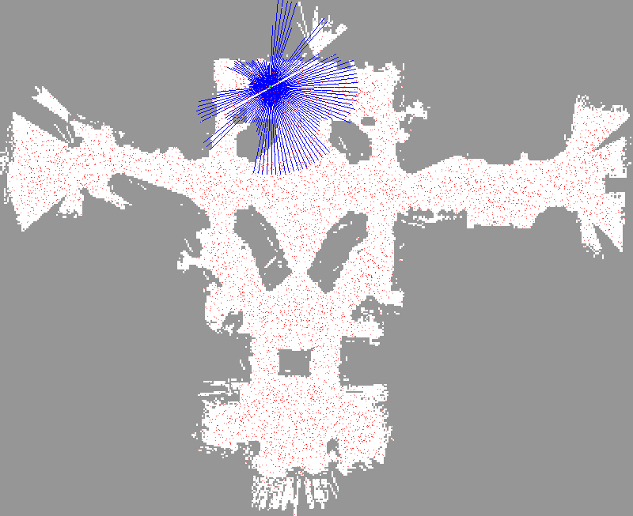

Slide 24
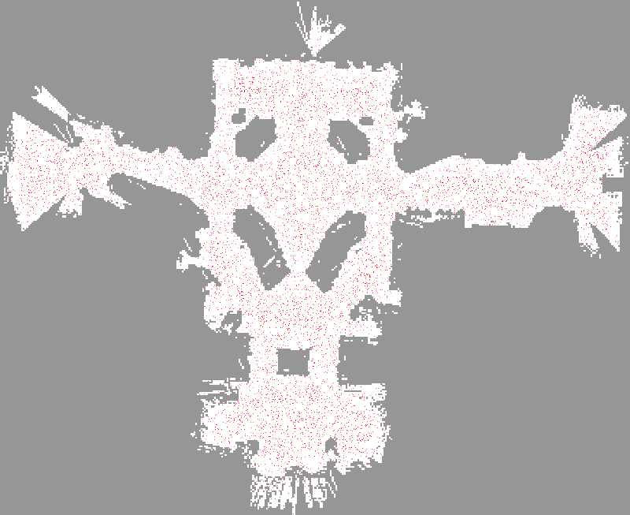

Slide 25
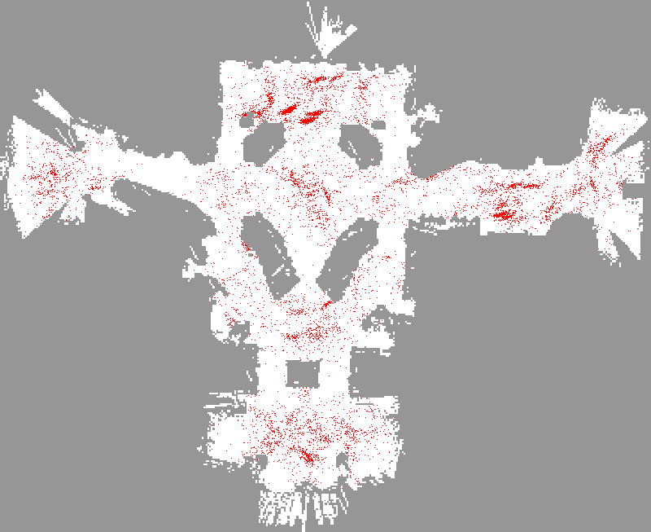

Slide 26
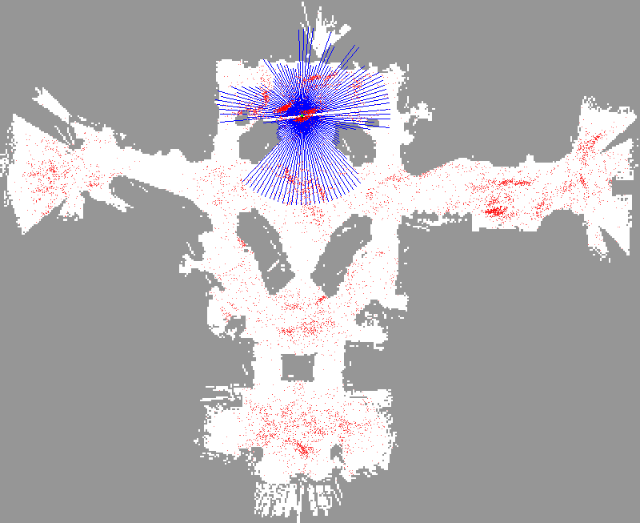

Slide 27
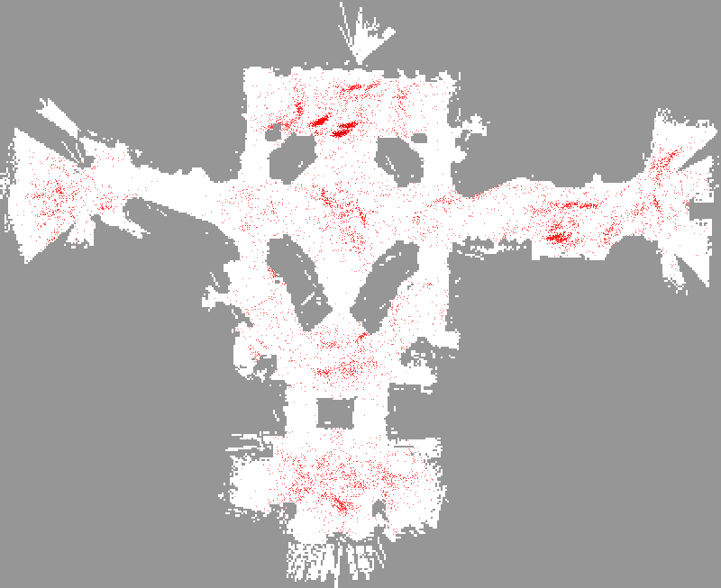

Slide 28
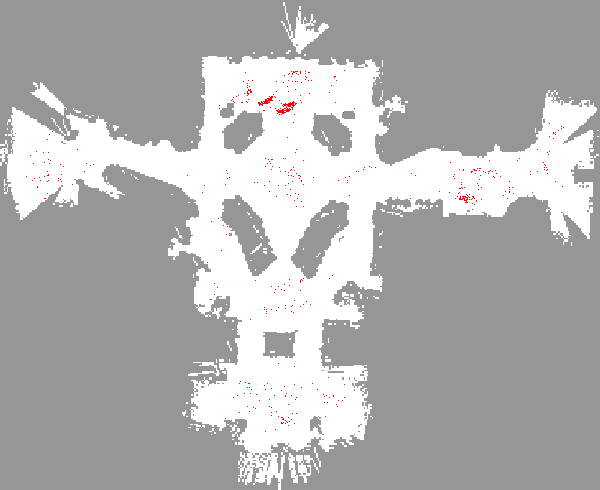

Slide 29
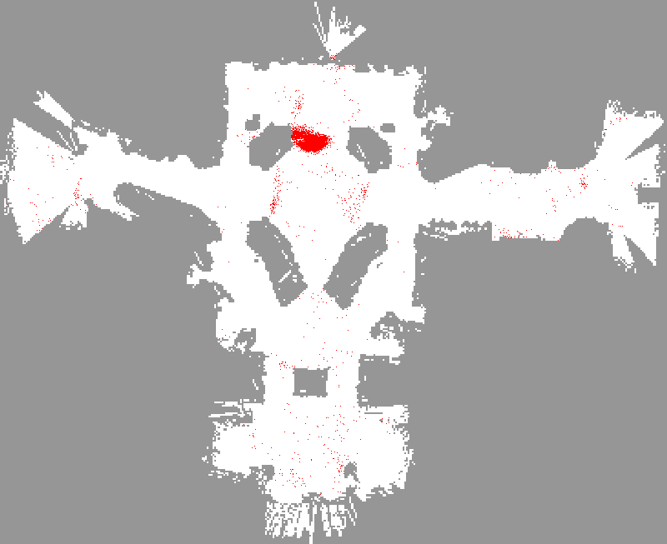

Slide 30
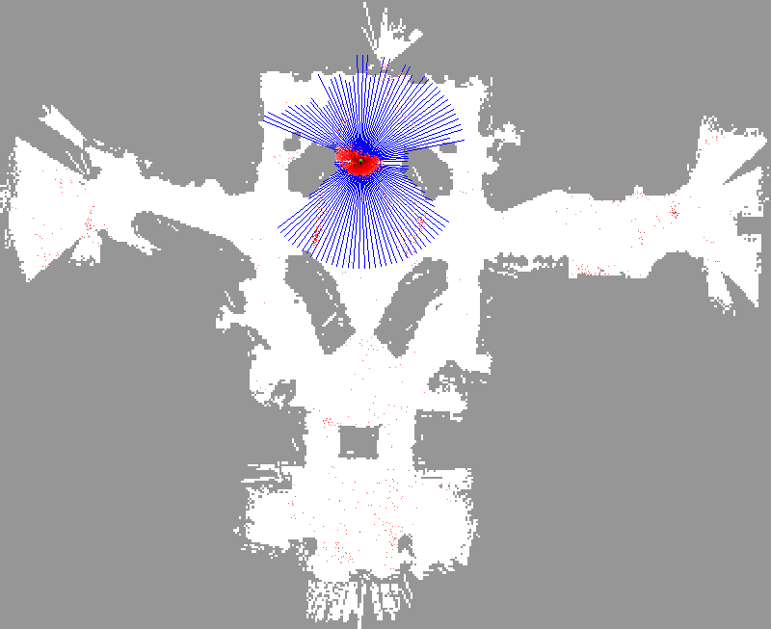

Slide 31


Slide 32
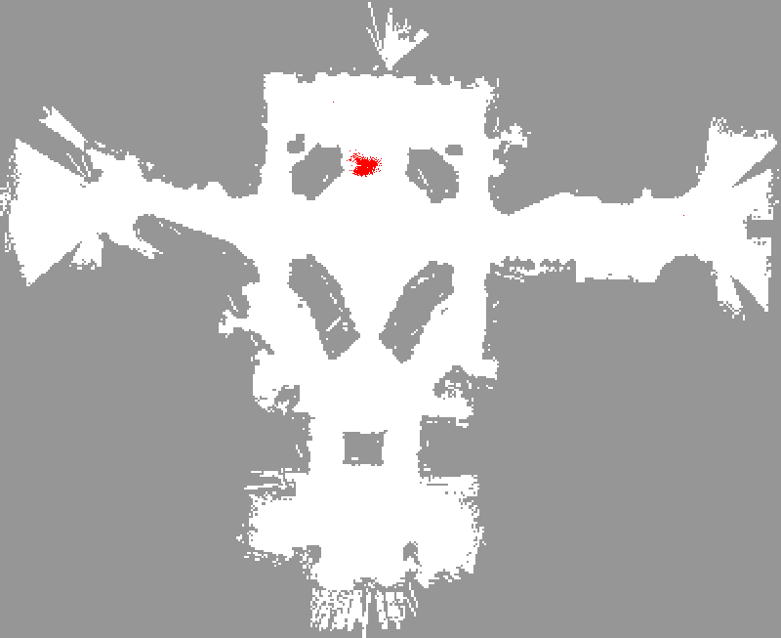

Slide 33
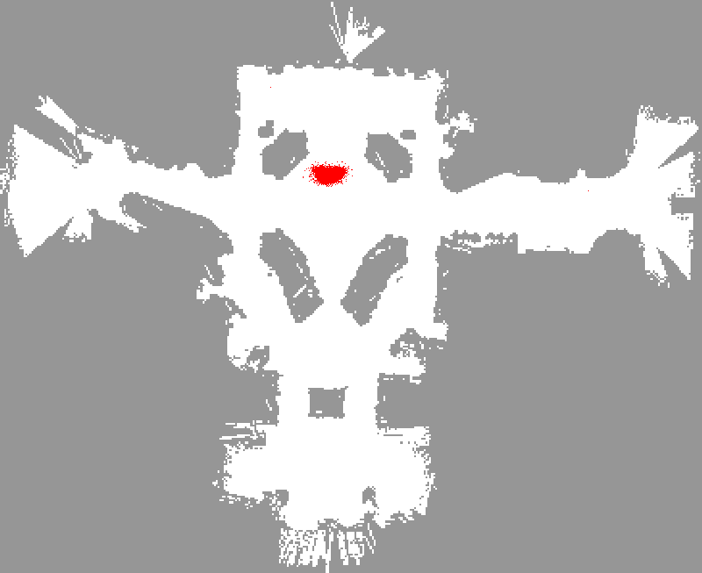

Slide 34
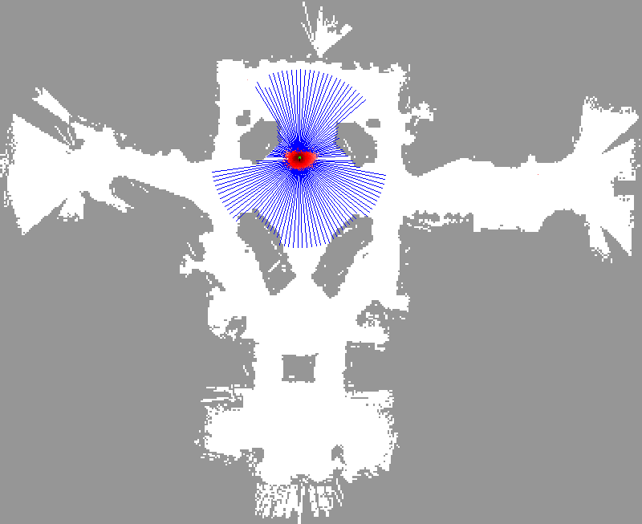

Slide 35
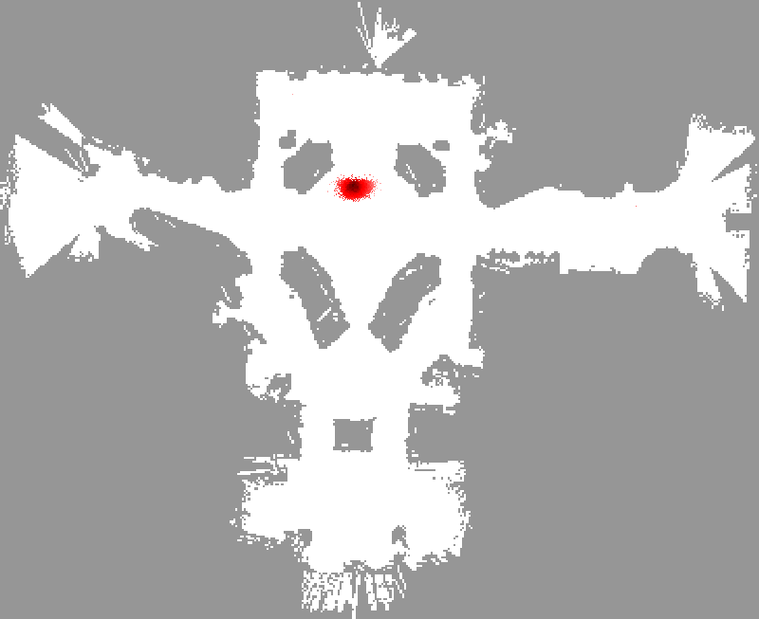

Slide 36
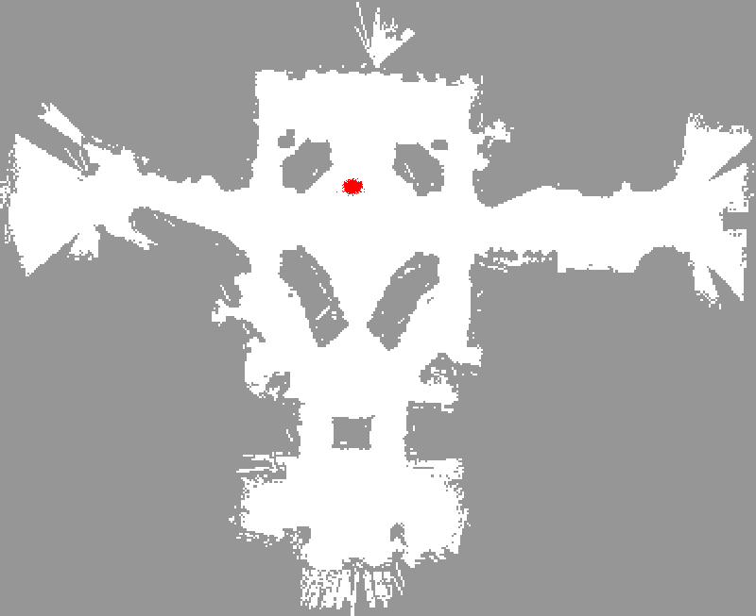

Slide 37


Slide 38
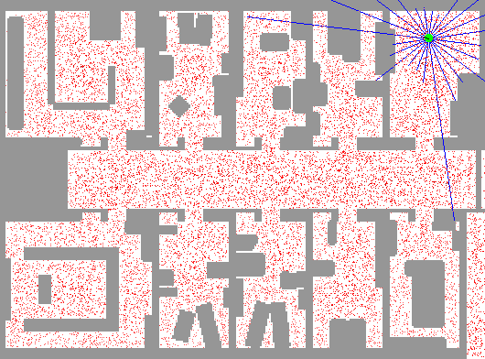
Sample-based Localization (sonar)

Slide 39
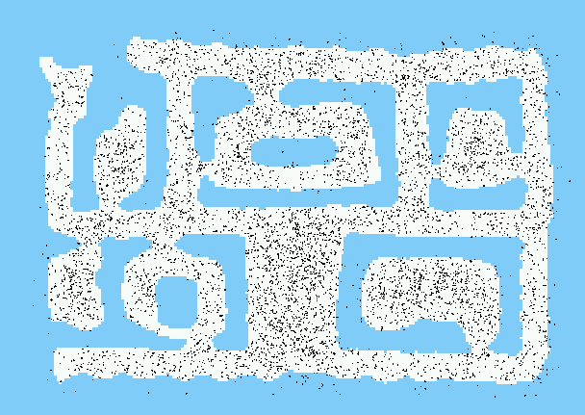
Initial Distribution

Slide 40

After Incorporating Ten Ultrasound Scans

Slide 41

After Incorporating 65 Ultrasound Scans

Slide 42
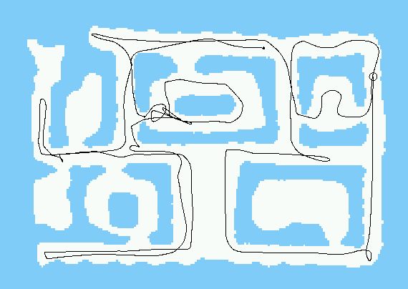
Estimated Path

Slide 43
Mobile Robot Localization
Each particle is a potential pose of the robot
Proposal distribution is the motion model of the robot (prediction step)
The observation model is used to compute the importance weight (correction step)

